Slide 1
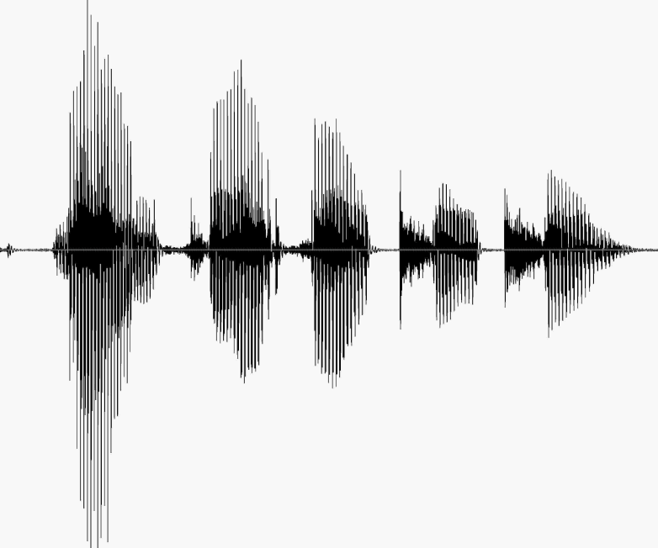
CS 224S / LINGUIST 285 Spoken Language Processing
Andrew Maas
Stanford University
Spring 2017
Lecture 2: Phonetics
Original slides by Dan Jurafsky

Slide 2
Homework 1
Out after lecture today. Due in 1 week
PDF handout linked on website syllabus
You’ll need to download PRAAT; details are in the homework.

Slide 3
Phonetics
ARPAbet
An alphabet for transcribing American English phonetic sounds.
Articulatory Phonetics
How speech sounds are made by articulators (moving organs) in mouth.
Acoustic Phonetics
Acoustic properties of speech sounds

Slide 4
ARPAbet
http://www.stanford.edu/class/cs224s/arpabet.html
The CMU Pronouncing Dictionary
http://www.speech.cs.cmu.edu/cgi-bin/cmudict
What about other languages?
International Phonetic Alphabet:
http://en.wikipedia.org/wiki/International_Phonetic_Alphabet

Slide 5
ARPAbet Vowels
 | b_d | ARPA |  | b_d | ARPA
1 | bead | iy | 9 | bode | ow
2 | bid | ih | 10 | booed | uw
3 | bayed | ey | 11 | bud | ah
4 | bed | eh | 12 | bird | er
5 | bad | ae | 13 | bide | ay
6 | bod(y) | aa | 14 | bowed | aw
7 | bawd | ao | 15 | Boyd | oy
8 | Budd(hist) | uh
Note: Many speakers pronounce Buddhist with the vowel uw as in booed,
So for them [uh] is instead the vowel in “put” or “book”
https://corpus.linguistics.berkeley.edu/acip/

Slide 6
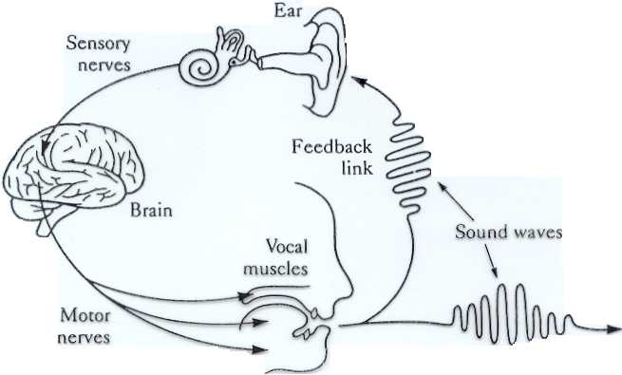
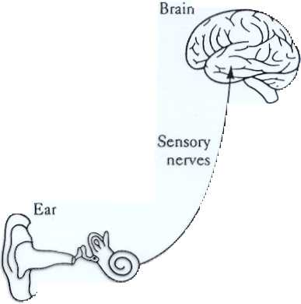
The Speech Chain (Denes and Pinson)
HEARER
SPEAKER

Slide 7
Speech Production Process
Respiration:
We (normally) speak while breathing out. Respiration provides airflow. “Pulmonic egressive airstream”
Phonation
Airstream sets vocal folds in motion. Vibration of vocal folds produces sounds. Sound is then modulated by:
Articulation and Resonance
Shape of vocal tract, characterized by:
Oral tract
Teeth, soft palate (velum), hard palate
Tongue, lips, uvula
Nasal tract
Text adopted from Sharon Rose

Slide 8
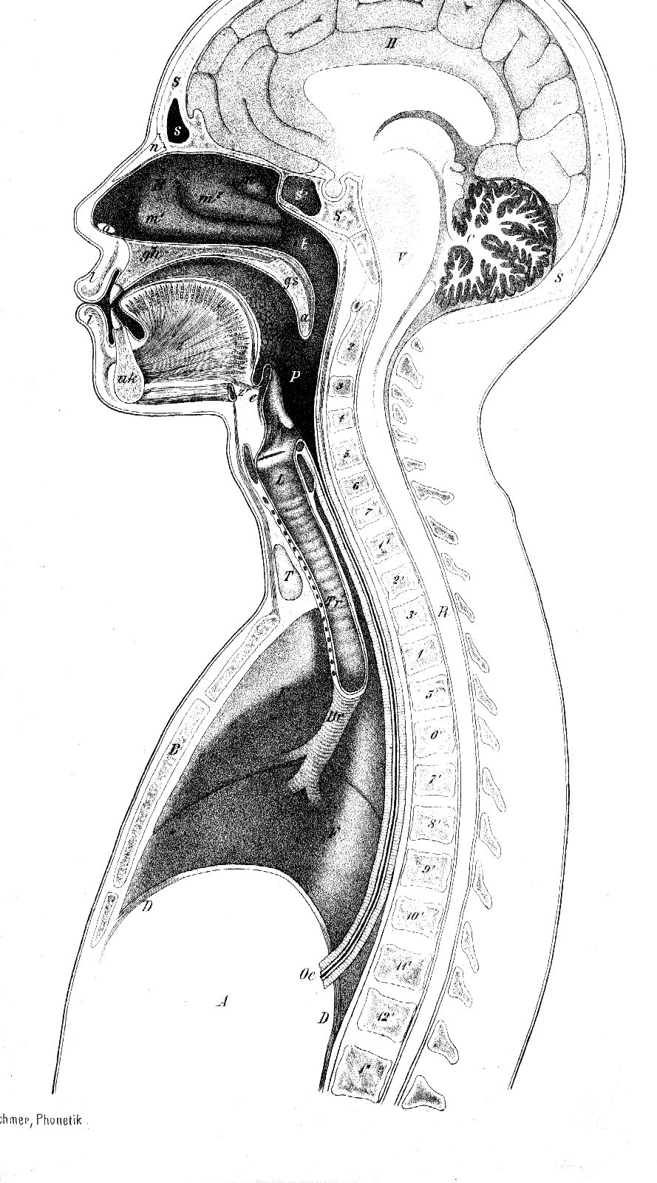
Sagittal section of the vocal tract
(Techmer 1880)
Nasal Cavity
Pharynx
Vocal Folds (within the Larynx)
Trachea
Lungs
Text copyright J. J. Ohala, Sept 2001, from Sharon Rose slide

Slide 9
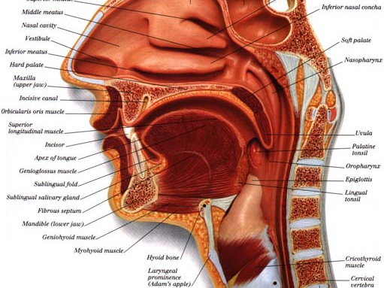
From Mark Liberman’s website, from Ultimate Visual Dictionary

Slide 10
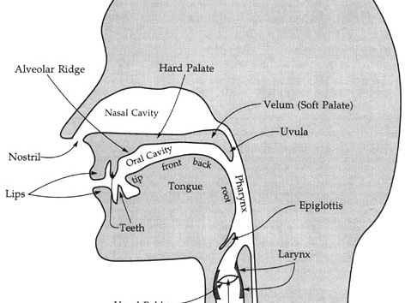
From Mark Liberman’s Web Site, from Language Files (7th ed)

Slide 11
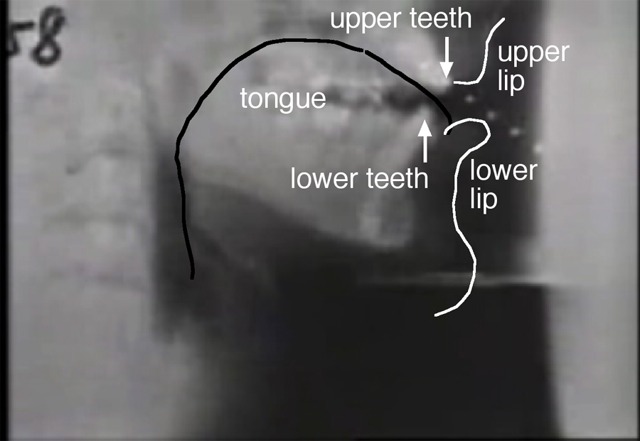
Figure of Ken Stevens, labels from Peter Ladefoged’s web site

Slide 12
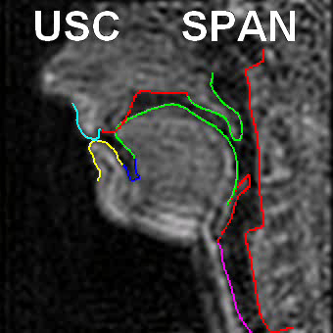
USC’s SAIL Lab Shri Narayanan

Slide 13
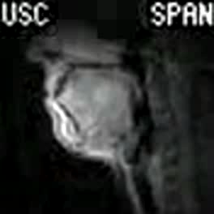

Slide 14
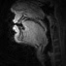
Tamil

Slide 15
Larynx and Vocal Folds
The Larynx (voice box)
A structure made of cartilage and muscle
Located above the trachea (windpipe) and below the pharynx (throat)
Contains the vocal folds
(adjective for larynx: laryngeal)
Vocal Folds (older term: vocal cords)
Two bands of muscle and tissue in the larynx
Can be set in motion to produce sound (voicing)
Text from slides by Sharon Rose UCSD LING 111 handout

Slide 16
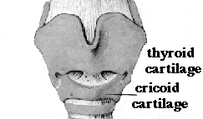
The larynx, external structure, from front
Figure thnx to John Coleman!!

Slide 17
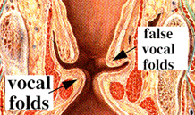
Vertical slice through larynx, as seen from back
Figure thnx to John Coleman!!

Slide 18
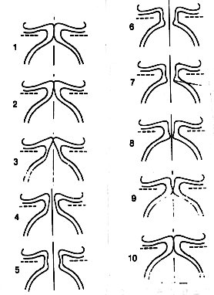
Voicing:
Air comes up from lungs
Forces its way through vocal cords, pushing open (2,3,4)
This causes air pressure in glottis to fall, since:
when gas runs through constricted passage, its velocity increases (Venturi tube effect)
this increase in velocity results in a drop in pressure (Bernoulli principle)
Because of drop in pressure, vocal cords snap together again (6-10)
Single cycle: ~1/100 of a second.
Figure & text from John Coleman’s web site

Slide 19
Voicelessness
When vocal cords are open, air passes through unobstructed
Voiceless sounds: p/t/k/s/f/sh/th/ch
If the air moves very quickly, the turbulence causes a different kind of phonation: whisper

Slide 20
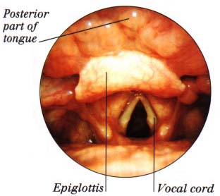
Vocal folds open during breathing
From Mark Liberman’s web site, from Ultimate Visual Dictionary

Slide 21
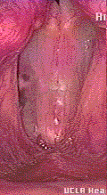
Vocal Fold Vibration
UCLA Phonetics Lab Demo

Slide 22
Consonants and Vowels
Consonants: phonetically, sounds with audible noise produced by a constriction
Vowels: phonetically, sounds with no audible noise produced by a constriction
(it’s more complicated than this, since we have to consider syllabic function, but this will do for now)
Text adapted from John Coleman

Slide 23
Place of Articulation
Consonants are classified according to the location where the airflow is most constricted.
This is called place of articulation
Three major kinds of place articulation:
Labial (with lips)
Coronal (using tip or blade of tongue)
Dorsal (using back of tongue)

Slide 24
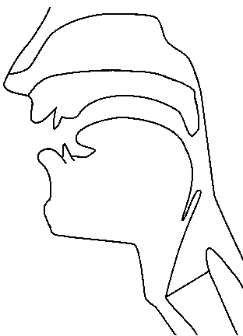
Places of articulation
alveolar
post-alveolar/palatal
dental
velar
uvular
labial
pharyngeal
laryngeal/glottal
Figure thanks to Jennifer Venditti

Slide 25
Coronal place
alveolar
post-alveolar/palatal
dental
Dental:
th/dh
Alveolar:
t/d/s/z/l
Post:
sh/zh/y
Figure thanks to Jennifer Venditti

Slide 26
Dorsal Place
velar
Velar:
k/g/ng
uvular
pharyngeal
Figure thanks to Jennifer Venditti

Slide 27
Manner of Articulation
Stop: complete closure of articulators, so no air escapes through mouth
Oral stop: palate is raised, no air escapes through nose. Air pressure builds up behind closure, explodes when released
p, t, k, b, d, g
Nasal stop: oral closure, but palate is lowered, air escapes through nose.
m, n, ng

Slide 28
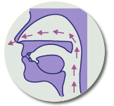
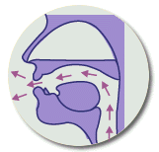
Oral vs. Nasal Sounds
Thanks to Jong-bok Kim for this figure!

Slide 29
More on Manner of articulation of consonants
Fricatives
Close approximation of two articulators, resulting in turbulent airflow between them, producing a hissing sound.
f, v, s, z, th, dh
Approximant
Not quite-so-close approximation of two articulators, so no turbulence
y, r
Lateral approximant
Obstruction of airstream along center of oral tract, with opening around sides of tongue.
l
Text from Ladefoged “A Course in Phonetics”

Slide 30
More on manner of articulation of consonants
Tap or flap
Tongue makes a single tap against the alveolar ridge
dx in “butter”
Affricate
Stop immediately followed by a fricative
ch, jh

Slide 31
Articulatory parameters for English consonants (in ARPAbet)
 | PLACE OF ARTICULATION
 |  | bilabial |  | labio-dental |  | inter-dental |  | alveolar |  | palatal |  | velar |  | glottal
 | stop | p | b |  |  |  |  | t | d |  |  | k | g | q
 | fric. |  |  | f | v | th | dh | s | z | sh | zh |  |  | h
 | affric. |  |  |  |  |  |  |  |  | ch | jh
 | nasal |  | m |  |  |  |  |  | n |  |  |  | ng
 | approx |  | w |  |  |  |  |  | l/r |  | y
 | flap |  |  |  |  |  |  | dx
MANNER OF ARTICULATION
VOICING:
voiceless | voiced
Table from Jennifer Venditti

Slide 32
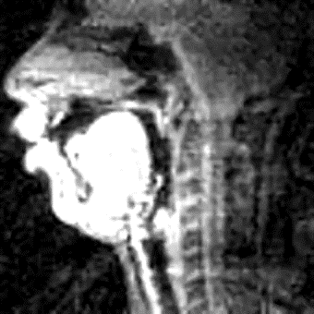
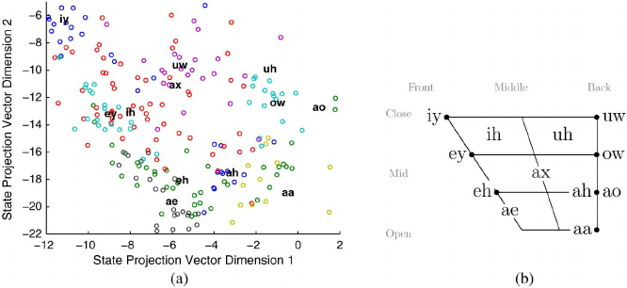
Tongue position for vowels

Slide 33
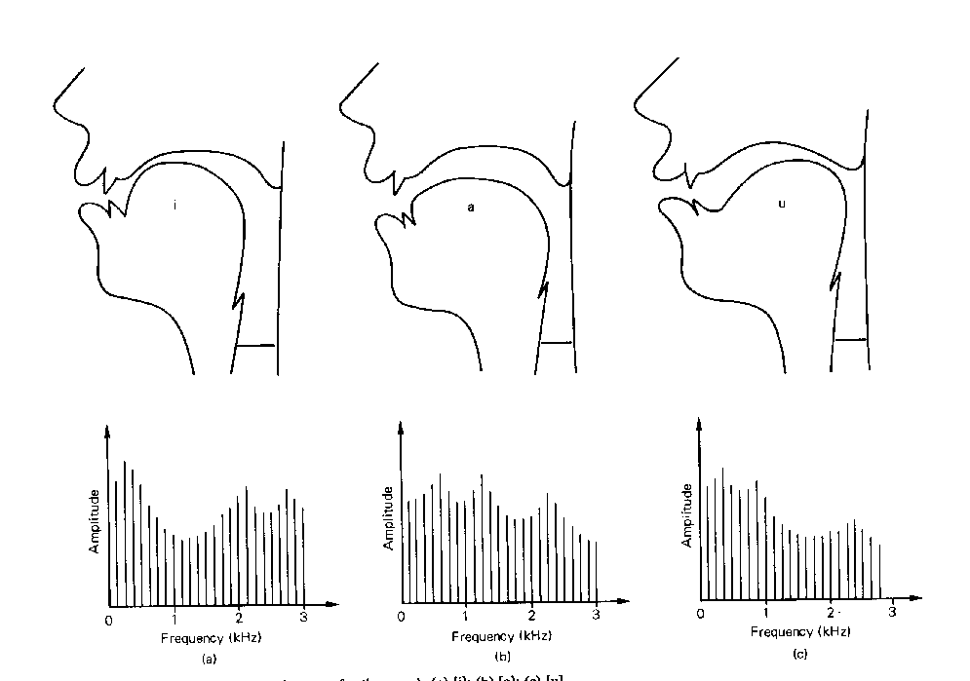
Vowels
IY
AA
UW
Fig. from Eric Keller

Slide 34
American English Vowel Space
HIGH
iy
uw
ih
ix
ux
uh
oy
ey
ow
ax
FRONT
BACK
eh
ah
aw
ao
ay
ae
aa
LOW
Red: Vowels, Blue: Dipthongs
Figure from Jennifer Venditti

Slide 35
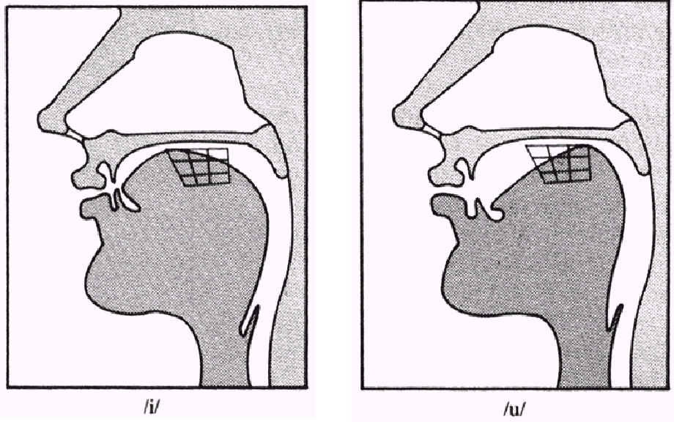
[iy] vs. [uw]
Figure from Jennifer Venditti, from a lecture given by Rochelle Newman

Slide 36
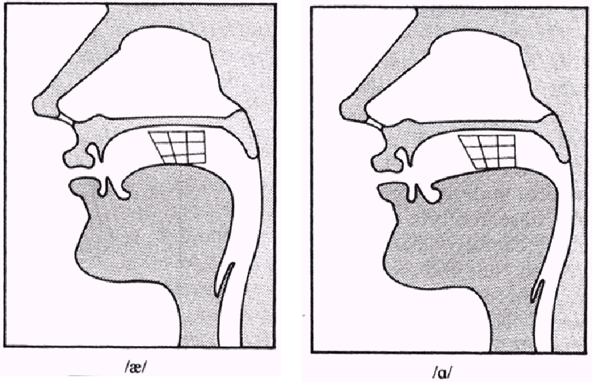
[ae] vs. [aa]
Figure from Jennifer Venditti, from a lecture given by Rochelle Newman

Slide 37
Where to go for more info
Ladefoged, Peter. 1993. A Course in Phonetics
Mark Liberman’s site
http://www.ling.upenn.edu/courses/Spring_2001/ling001/phonetics.html
John Coleman’s site
http://www.phon.ox.ac.uk/%7Ejcoleman/mst_mphil_phonetics_course_index.html
Jennifer Smith’s resource page
http://www.unc.edu/~jlsmith/pht-url.html

Slide 38
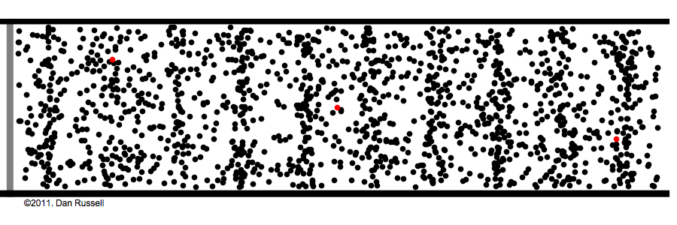
Sound waves are longitudinal waves
Dan Rusell Figure

Slide 39
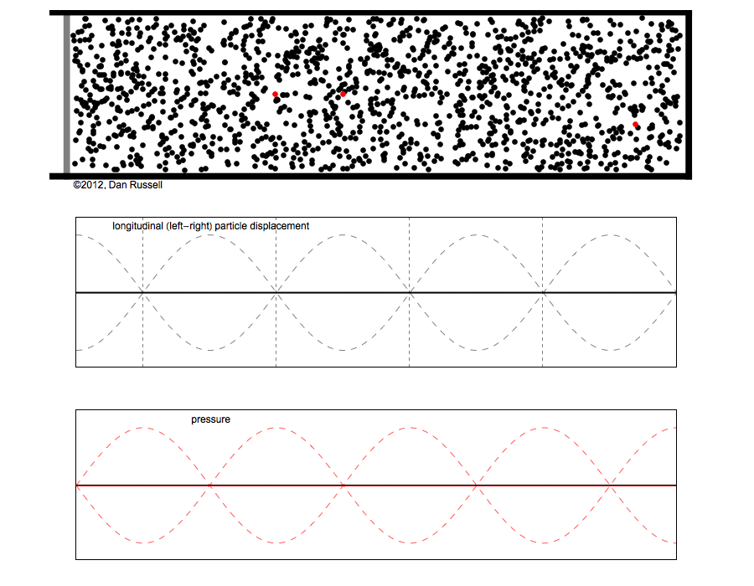
particle dispacment
pressure
Dan Rusell Figure

Slide 40
Remember High School Physics Simple Period Waves (sine waves)
Characterized by:
period: T
amplitude A
phase φ
Fundamental frequency
in cycles per second, or Hz
F₀=1/T
1 cycle
To listen to sine waves: http://www.szynalski.com/tone-generator/

Slide 41
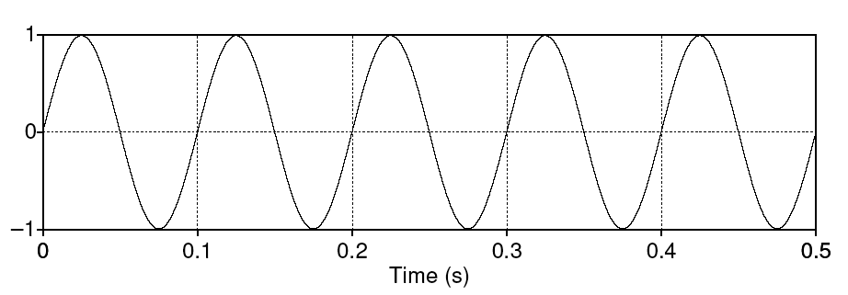
Simple periodic waves
Computing the frequency of a wave:
5 cycles in .5 seconds = 10 cycles/second = 10 Hz
Amplitude:
1
Equation:
Y = A sin(2πft)
The frequency of a wave:
5 cycles in .5 seconds = 10 cycles/second = 10 Hz
Amplitude: 1

Slide 42
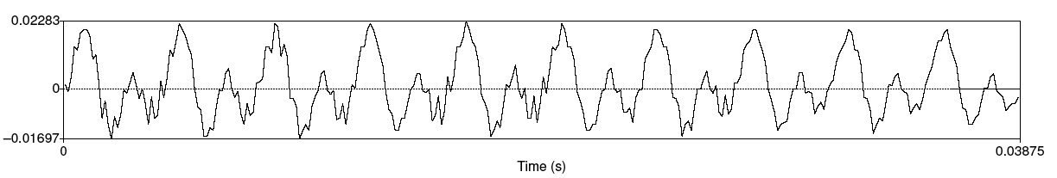
Speech sound waves
A little piece from the waveform of the vowel [iy]
X axis: time.
Y axis:
Amplitude = air pressure at that time
+: compression
0: normal air pressure,
-: rarefaction

Slide 43
Back to waves: Fundamental frequency
Waveform of the vowel [iy]
Frequency: 10 repetitions / .03875 seconds = 258 Hz
This is speed that vocal folds move, hence voicing
Each peak corresponds to an opening of the vocal folds
The low frequency of the complex wave is called the fundamental frequency of the wave or F0

Slide 44

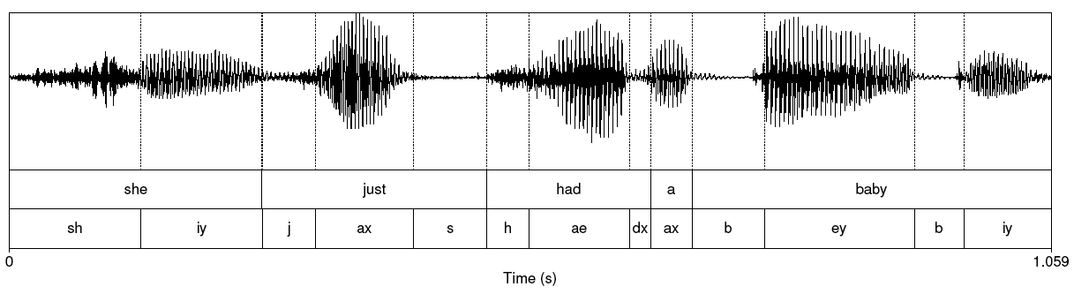
She just had a baby
Note that vowels all have regular amplitude peaks
Stop consonant
Closure followed by release
Notice the silence followed by slight bursts of emphasis: very clear for [b] of “baby”
Fricative: noisy. [sh] of “she” at beginning

Slide 45
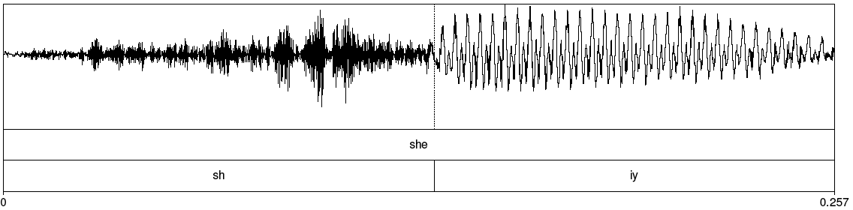
Fricative

Slide 46
Back to freshman physics: Waves have different frequencies
100 Hz
1000 Hz

Slide 47
Complex waves: Adding a 100 Hz and 1000 Hz wave together

Slide 48
Spectrum
Amplitude
100
Frequency in Hz
1000
Frequency components (100 and 1000 Hz) on x-axis

Slide 49
Spectra continued
Fourier analysis: any wave can be represented as the (infinite) sum of sine waves of different frequencies (amplitude, phase)

Slide 50
Spectrum of one instant in an actual soundwave: many components across frequency range

Slide 51
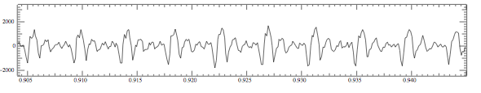
Part of [ae] waveform from “had”
Note complex wave repeating nine times in figure
Plus smaller waves which repeats 4 times for every large pattern
Large wave has frequency of 250 Hz (9 times in .036 seconds)
Small wave roughly 4 times this, or roughly 1000 Hz
Two little tiny waves on top of peak of 1000 Hz waves

Slide 52
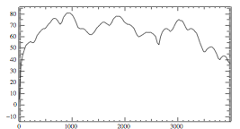
Back to spectrum
Spectrum represents these freq components
Computed by Fourier transform
x-axis shows frequency, y-axis shows magnitude (in decibels)
Peaks at 930 Hz, 1860 Hz, and 3020 Hz.

Slide 53
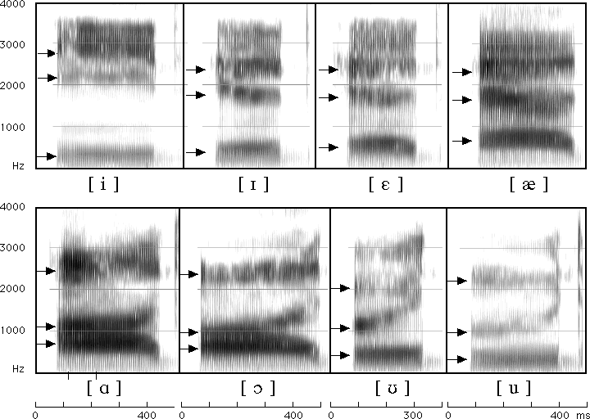
Seeing formants: the spectrogram

Slide 54
Formants
Vowels largely distinguished by 2 characteristic pitches.
One of them (the higher of the two) goes downward throughout the series iy ih eh ae aa ao ou u
The other goes up for the first four vowels and then down for the next four.
These are called "formants" of the vowels, lower is 1st formant, higher is 2nd formant.

Slide 55
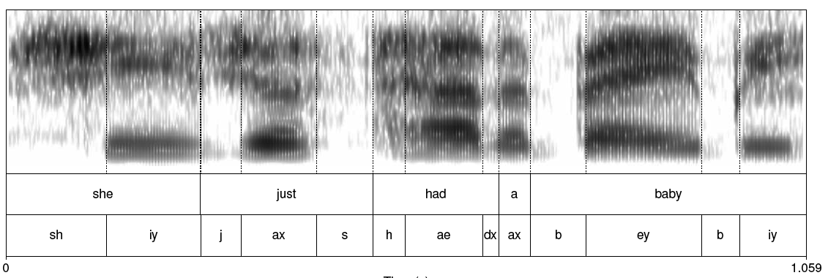
Spectrogram: spectrum + time dimension

Slide 56
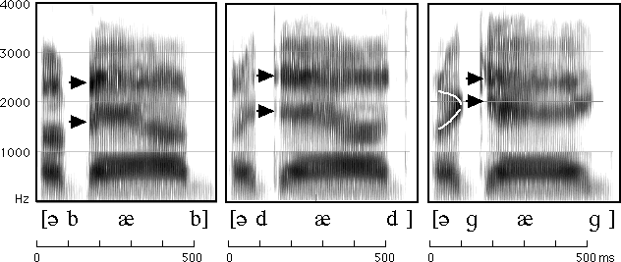
How to read spectrograms
bab: closure of lips lowers all formants: so rapid increase in all formants at beginning of "bab”
dad: first formant increases, but F2 and F3 slight fall
gag: F2 and F3 come together: this is a characteristic of velars. Formant transitions take longer in velars than in alveolars or labials
From Ladefoged “A Course in Phonetics”

Slide 57
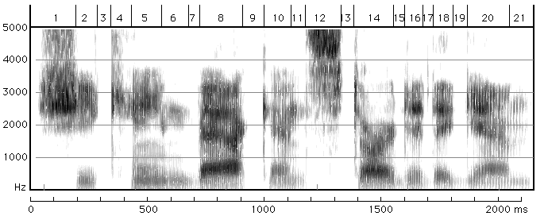
She came back and started again
1. lots of high-freq energy
3. closure for k
4. burst of aspiration for k
5. ey vowel;faint 1100 Hz formant is nasalization
6. bilabial nasal
7. short b closure, voicing barely visible.
8. ae; note upward transitions after bilabial stop at beginning
9. note F2 and F3 coming together for "k”
From Ladefoged “A Course in Phonetics”

Slide 58
Praat example
http://www.fon.hum.uva.nl/praat/

Slide 59
Different vowels have different formants
Every time the vocal cords open and close, pulse of air from the lungs is sharp tap on air in vocal tract.
Setting air in vocal cavity vibrating, producing different harmonics

Slide 60
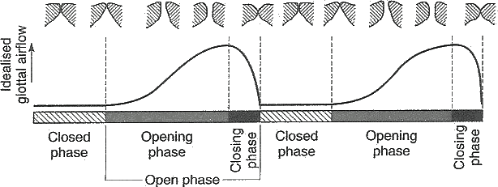
Vocal Fold Cycles

Slide 61
The vocal source at 150 Hz
a

Slide 62
The harmonics
a

Slide 63
Source filter model of vowels
Any body of air will vibrate in a way that depends on its size and shape.
Vocal tract as "amplifier"; amplifies certain harmonics
Formants are result of different shapes of vocal tract.

Slide 64
The oral cavity amplifies some harmonics
a

Slide 65
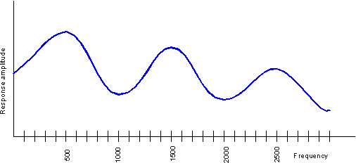
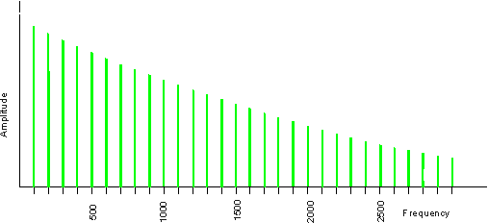
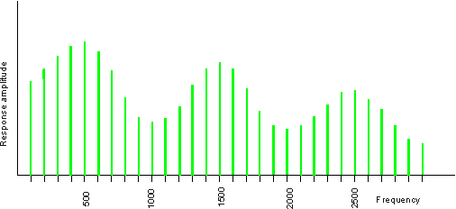
Source-filter model of speech production
Input
Filter
Output
Glottal spectrum
Vocal tract frequency
response function
Source and filter are independent, so:
Different vowels can have same pitch
The same vowel can have different pitch
Figures and text from Ratree Wayland slide from his website

Slide 66
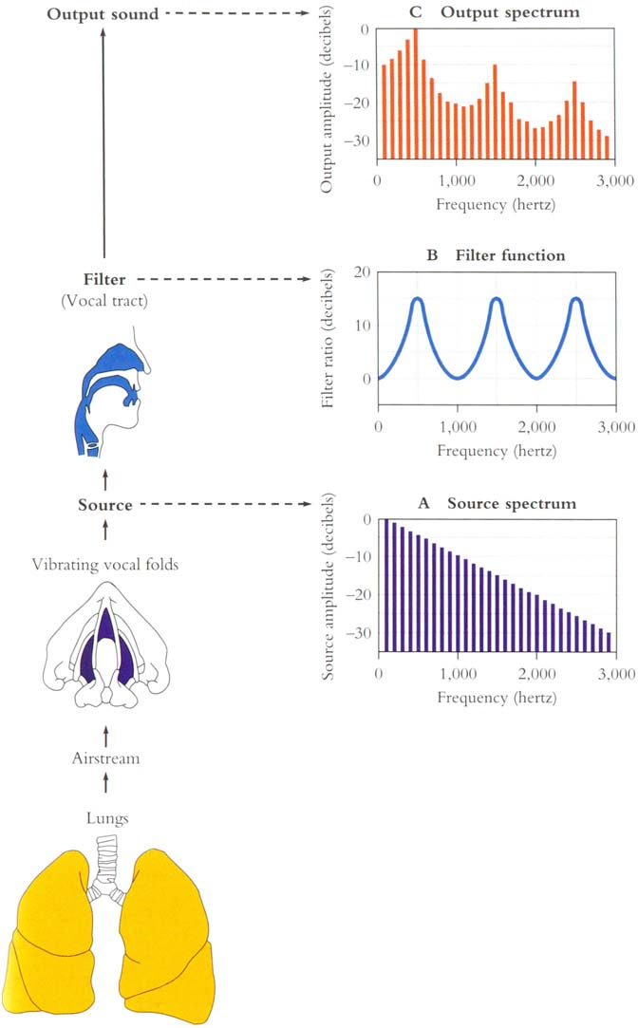

Slide 67
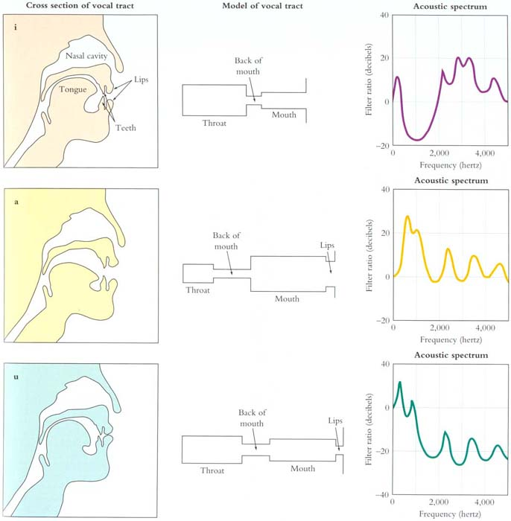
From
Mark
Liberman’s
Web site

Slide 68
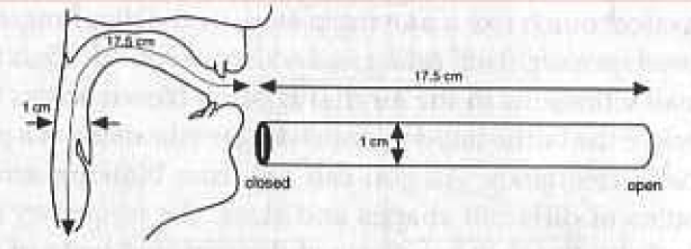
Resonances of the vocal tract
The human vocal tract as an open tube
Air in a tube of a given length will tend to vibrate at resonance frequency of tube.
Closed end
Open end
Length 17.5 cm.
Figure from Ladefoged(1996) p 117

Slide 69
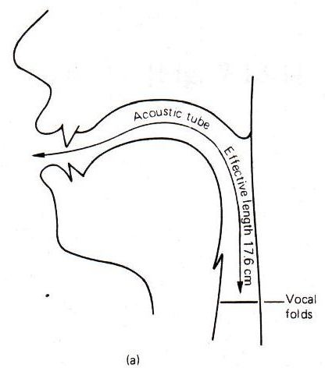
Resonances of the vocal tract
The human vocal tract as an open tube
Air in a tube of a given length will tend to vibrate at resonance frequency of tube.
Closed end
Open end
Length 17.5 cm.
Figure from W. Barry Speech Science slides

Slide 70
Resonances of the vocal tract
If vocal tract is cylindrical tube open at one end
Standing waves form in tubes
Waves will resonate if their wavelength corresponds to dimensions of tube
Constraint: Pressure differential should be maximal at (closed) glottal end and minimal at (open) lip end.
Next slide shows what kind of length of waves can fit into a tube with this contraint

Slide 71
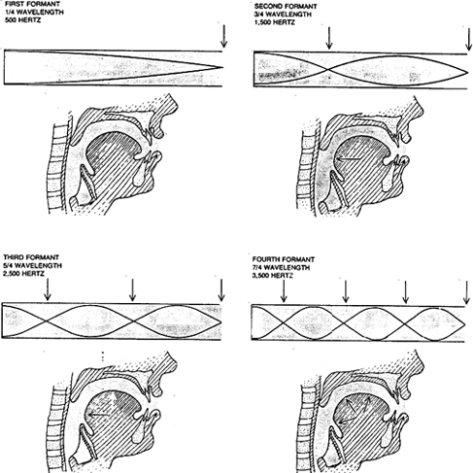
From Sundberg

Slide 72
Defining Intonation
Ladd (1996) “Intonational phonology”
“The use of suprasegmental phonetic features
Suprasegmental = above & beyond the segment/phone
F0
Intensity (energy)
Duration
to convey sentence-level pragmatic meanings”
I.e. meanings that apply to phrases or utterances as a whole, not lexical stress, not lexical tone.

Slide 73
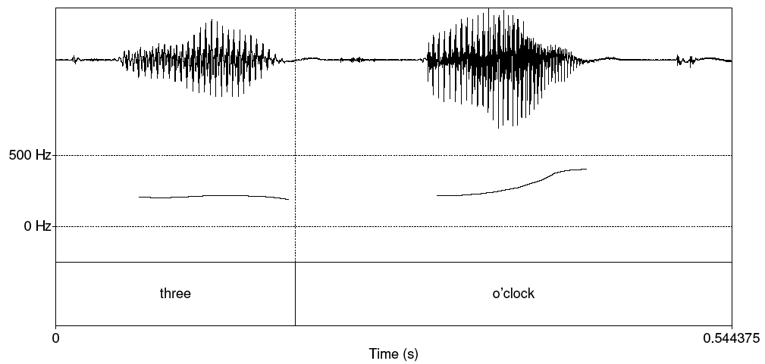
Pitch track

Slide 74
Pitch is not Frequency
Pitch is the mental sensation or perceptual correlated of F0
Relationship between pitch and F0 is not linear;
human pitch perception is most accurate between 100Hz and 1000Hz.
Linear in this range
Logarithmic above 1000Hz
Mel scale is one model of this F0-pitch mapping
A mel is a unit of pitch defined so that pairs of sounds which are perceptually equidistant in pitch are separated by an equal number of mels
Frequency in mels = 1127 ln (1 + f/700)

Slide 75
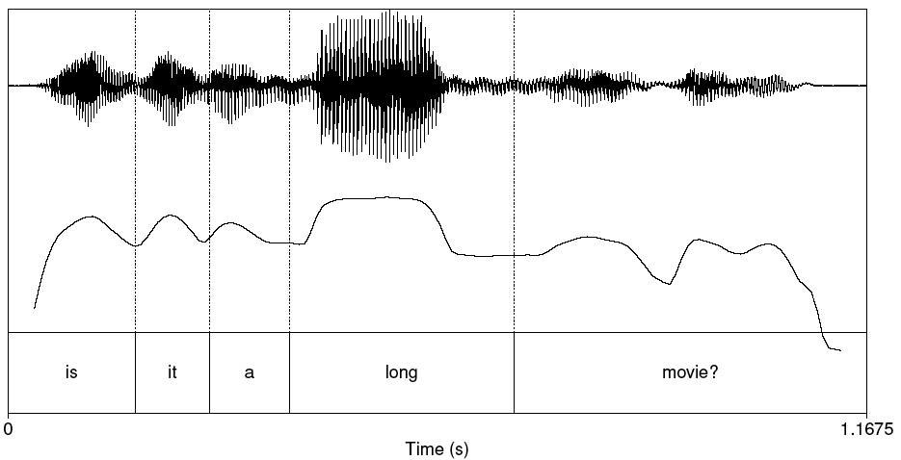
Plot of Intensity

Slide 76
Three aspects of prosody
Prominence: some syllables/words are more prominent than others
Structure/boundaries: sentences have prosodic structure
Some words group naturally together
Others have a noticeable break or disjuncture between them
Tune: the intonational melody of an utterance.
From Ladd (1996)

Slide 77

Prosodic Boundaries
I met Mary and Elena’s mother at the mall yesterday.
I met Mary and Elena’s mother at the mall yesterday.
French [bread and cheese]
[French bread] and [cheese]
Slide from Jennifer Venditti

Slide 78
Intonational tunes

Slide 79
Yes-No question tune
are LEGUMES a good source of vitamins
Rise from the main accent to the end of the sentence.
Slide from Jennifer Venditti

Slide 80
Yes-No question tune
are legumes a GOOD source of vitamins
Rise from the main accent to the end of the sentence.
Slide from Jennifer Venditti

Slide 81
Yes-No question tune
are legumes a good source of VITAMINS
Rise from the main accent to the end of the sentence.
Slide from Jennifer Venditti

Slide 82
WH-questions
[I know that many natural foods are healthy, but ...]
WHAT are a good source of vitamins
WH-questions typically have falling contours, like statements.
Slide from Jennifer Venditti

Slide 83
Broad focus
“Tell me something about the world.”
legumes are a good source of vitamins
In the absence of narrow focus, English tends to mark the first
and last ‘content’ words with perceptually prominent accents.
Slide from Jennifer Venditti

Slide 84
Rising statements
“Tell me something I didn’t already know.”
legumes are a good source of vitamins
[... does this statement qualify?]
High-rising statements can signal that the speaker
is seeking approval.
Slide from Jennifer Venditti

Slide 85
Yes-No question
are legumes a good source of VITAMINS
Rise from the main accent to the end of the sentence.
Slide from Jennifer Venditti

Slide 86
‘Surprise-redundancy’ tune
[How many times do I have to tell you ...]
legumes are a good source of vitamins
Low beginning followed by a gradual rise to a high at the end.
Slide from Jennifer Venditti

Slide 87
‘Contradiction’ tune
“I’ve heard that linguini is a good source of vitamins.”
linguini isn’t a good source of vitamins
[... how could you think that?]
Sharp fall at the beginning, flat and low, then rising at the end.
Slide from Jennifer Venditti

Slide 88
Thinking about F0

Slide 89
Graphic representation of F0
F0 (in Hertz)
legumes are a good source of VITAMINS
time
Slide from Jennifer Venditti

Slide 90
The ‘ripples’
[ s ]
[ s ]
[ t ]
legumes are a good source of VITAMINS
F0 is not defined for consonants without vocal
fold vibration.
Slide from Jennifer Venditti

Slide 91
The ‘ripples’
[ g ]
[ z ]
[ g ]
[ v ]
legumes are a good source of VITAMINS
... and F0 can be perturbed by consonants with
an extreme constriction in the vocal tract.
Slide from Jennifer Venditti

Slide 92
Abstraction of the F0 contour
legumes are a good source of VITAMINS
Our perception of the intonation contour abstracts
away from these perturbations.
Slide from Jennifer Venditti

Slide 93
The ‘waves’ and the ‘swells’
‘wave’ = accent
‘swell’ = phrase
legumes are a good source of VITAMINS
Slide from Jennifer Venditti

Slide 94
Prominence:
Placement of Pitch Accents

Slide 95
Stress vs. accent
Stress is a structural property of a word
it marks a potential (arbitrary) location for an accent to occur, if there is one.
Accent is a property of a word in context
it is a way to mark intonational prominence in order to ‘highlight’ important words in the discourse.
(x) |  |  |  |  |  | (x) |  |  | (accented syll)
x |  |  |  |  |  | x |  |  | stressed syll
x |  |  |  | x |  | x |  |  | full vowels
x | x | x |  | x | x | x | x |  | syllables
vi | ta | mins |  | Ca | li | for | nia
Slide from Jennifer Venditti

Slide 96
Stress vs. accent (2)
The speaker decides to make the word vitamin more prominent by accenting it.
Lexical stress tell us that this prominence will appear on the first syllable, hence VItamin.
So prosodic prominence is a function of
lexicon
context
I’m a little surPRISED to hear it CHARacterized as upBEAT

Slide 97
Which word receives an accent?
It depends on the context.
The ‘new’ information in the answer to a question is often accented
while the ‘old’ information is usually not.
Q1: What types of foods are a good source of vitamins?
A1: LEGUMES are a good source of vitamins.
Q2: Are legumes a source of vitamins?
A2: Legumes are a GOOD source of vitamins.
Q3: I’ve heard that legumes are healthy, but what are they a good source of ?
A3: Legumes are a good source of VITAMINS.
Slide from Jennifer Venditti

Slide 98
Same ‘tune’, different alignment
LEGUMES are a good source of vitamins
The main rise-fall accent (= “I assert this”) shifts locations.
Slide from Jennifer Venditti

Slide 99
Same ‘tune’, different alignment
Legumes are a GOOD source of vitamins
The main rise-fall accent (= “I assert this”) shifts locations.
Slide from Jennifer Venditti

Slide 100
Same ‘tune’, different alignment
legumes are a good source of VITAMINS
The main rise-fall accent (= “I assert this”) shifts locations.
Slide from Jennifer Venditti

Slide 101
Levels of prominence
Most phrases have more than one accent
The last accent in a phrase is perceived as more prominent
Called the Nuclear Accent
Emphatic accents like nuclear accent often used for semantic purposes, such as indicating that a word is contrastive, or the semantic focus.
The kind of thing you uses ***s in IM, or capitalized letters
‘I know SOMETHING interesting is sure to happen,’ she said to herself.
Can also have words that are less prominent than usual
Reduced words, especially function words.
Often use 4 classes of prominence:
Emphatic accent, pitch accent, unaccented, reduced

Slide 102
Intonational phrasing/boundaries

Slide 103
A single intonation phrase
legumes are a good source of vitamins
Broad focus statement consisting of one intonation phrase
(that is, one intonation tune spans the whole unit).
Slide from Jennifer Venditti

Slide 104
Multiple phrases
legumes are a good source of vitamins
Utterances can be ‘chunked’ up into smaller phrases
in order to signal the importance of information in each unit.
Slide from Jennifer Venditti

Slide 105
Phrasing sometimes helps disambiguate
Global ambiguity:
The old men and women stayed home.
Sally saw the man with the binoculars.
John doesn’t drink because he’s unhappy.
Slide from Jennifer Venditti

Slide 106
Phrasing can disambiguate
Global ambiguity:
The old men and women stayed home.
The old men % and women % stayed home.
Sally saw % the man with the binoculars.
Sally saw the man % with the binoculars.
John doesn’t drink because he’s unhappy.
John doesn’t drink % because he’s unhappy.
Slide from Jennifer Venditti

Slide 107
Phrasing sometimes helps disambiguate
Temporary ambiguity:
When Madonna sings the song ...
Slide from Jennifer Venditti

Slide 108
Phrasing sometimes helps disambiguate
Temporary ambiguity:
When Madonna sings the song is a hit.
Slide from Jennifer Venditti

Slide 109
Phrasing sometimes helps disambiguate
Temporary ambiguity:
When Madonna sings % the song is a hit.
When Madonna sings the song % it’s a hit.
[from Speer & Kjelgaard (1992)]
Slide from Jennifer Venditti

Slide 110
Phrasing sometimes helps disambiguate
Mary & Elena’s mother
mall
I met Mary and Elena’s mother at the mall yesterday
One intonation phrase with relatively flat overall pitch range.
Slide from Jennifer Venditti

Slide 111
Phrasing sometimes helps disambiguate
Elena’s mother
mall
Mary
I met Mary and Elena’s mother at the mall yesterday
Separate phrases, with expanded pitch movements.
Slide from Jennifer Venditti

Slide 112
Using Intonation in Spoken Language Processing
Prominence/Accent: Tells us about focus of utterance
Tune: whether utterance is question/statement, important for affect extraction
Boundaries: can help parsing

Slide 113
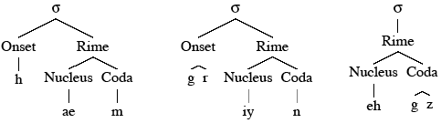
More phonetic structure
Syllables
Composed of vowels and consonants. Not well defined. Something like a “vowel nucleus with some of its surrounding consonants”.

Slide 114
More phonetic structure
Stress
Some syllables have more energy than others
Stressed syllables versus unstressed syllables
(an) ‘INsult vs. (to) in’SULT
(an) ‘OBject vs. (to) ob’JECT
Simple model: every multi-syllabic word has one syllable with:
“primary stress”
We can represent by using the number “1” on the vowel (and an implicit unmarking on the other vowels)
“table”: t ey1 b ax l
“machine: m ax sh iy1 n
Also possible: “secondary stress”, marked with a “2”
ih-2 n f axr m ey-1 sh ax n
Third category: reduced: schwa:
ax

Slide 115
